Slide 1
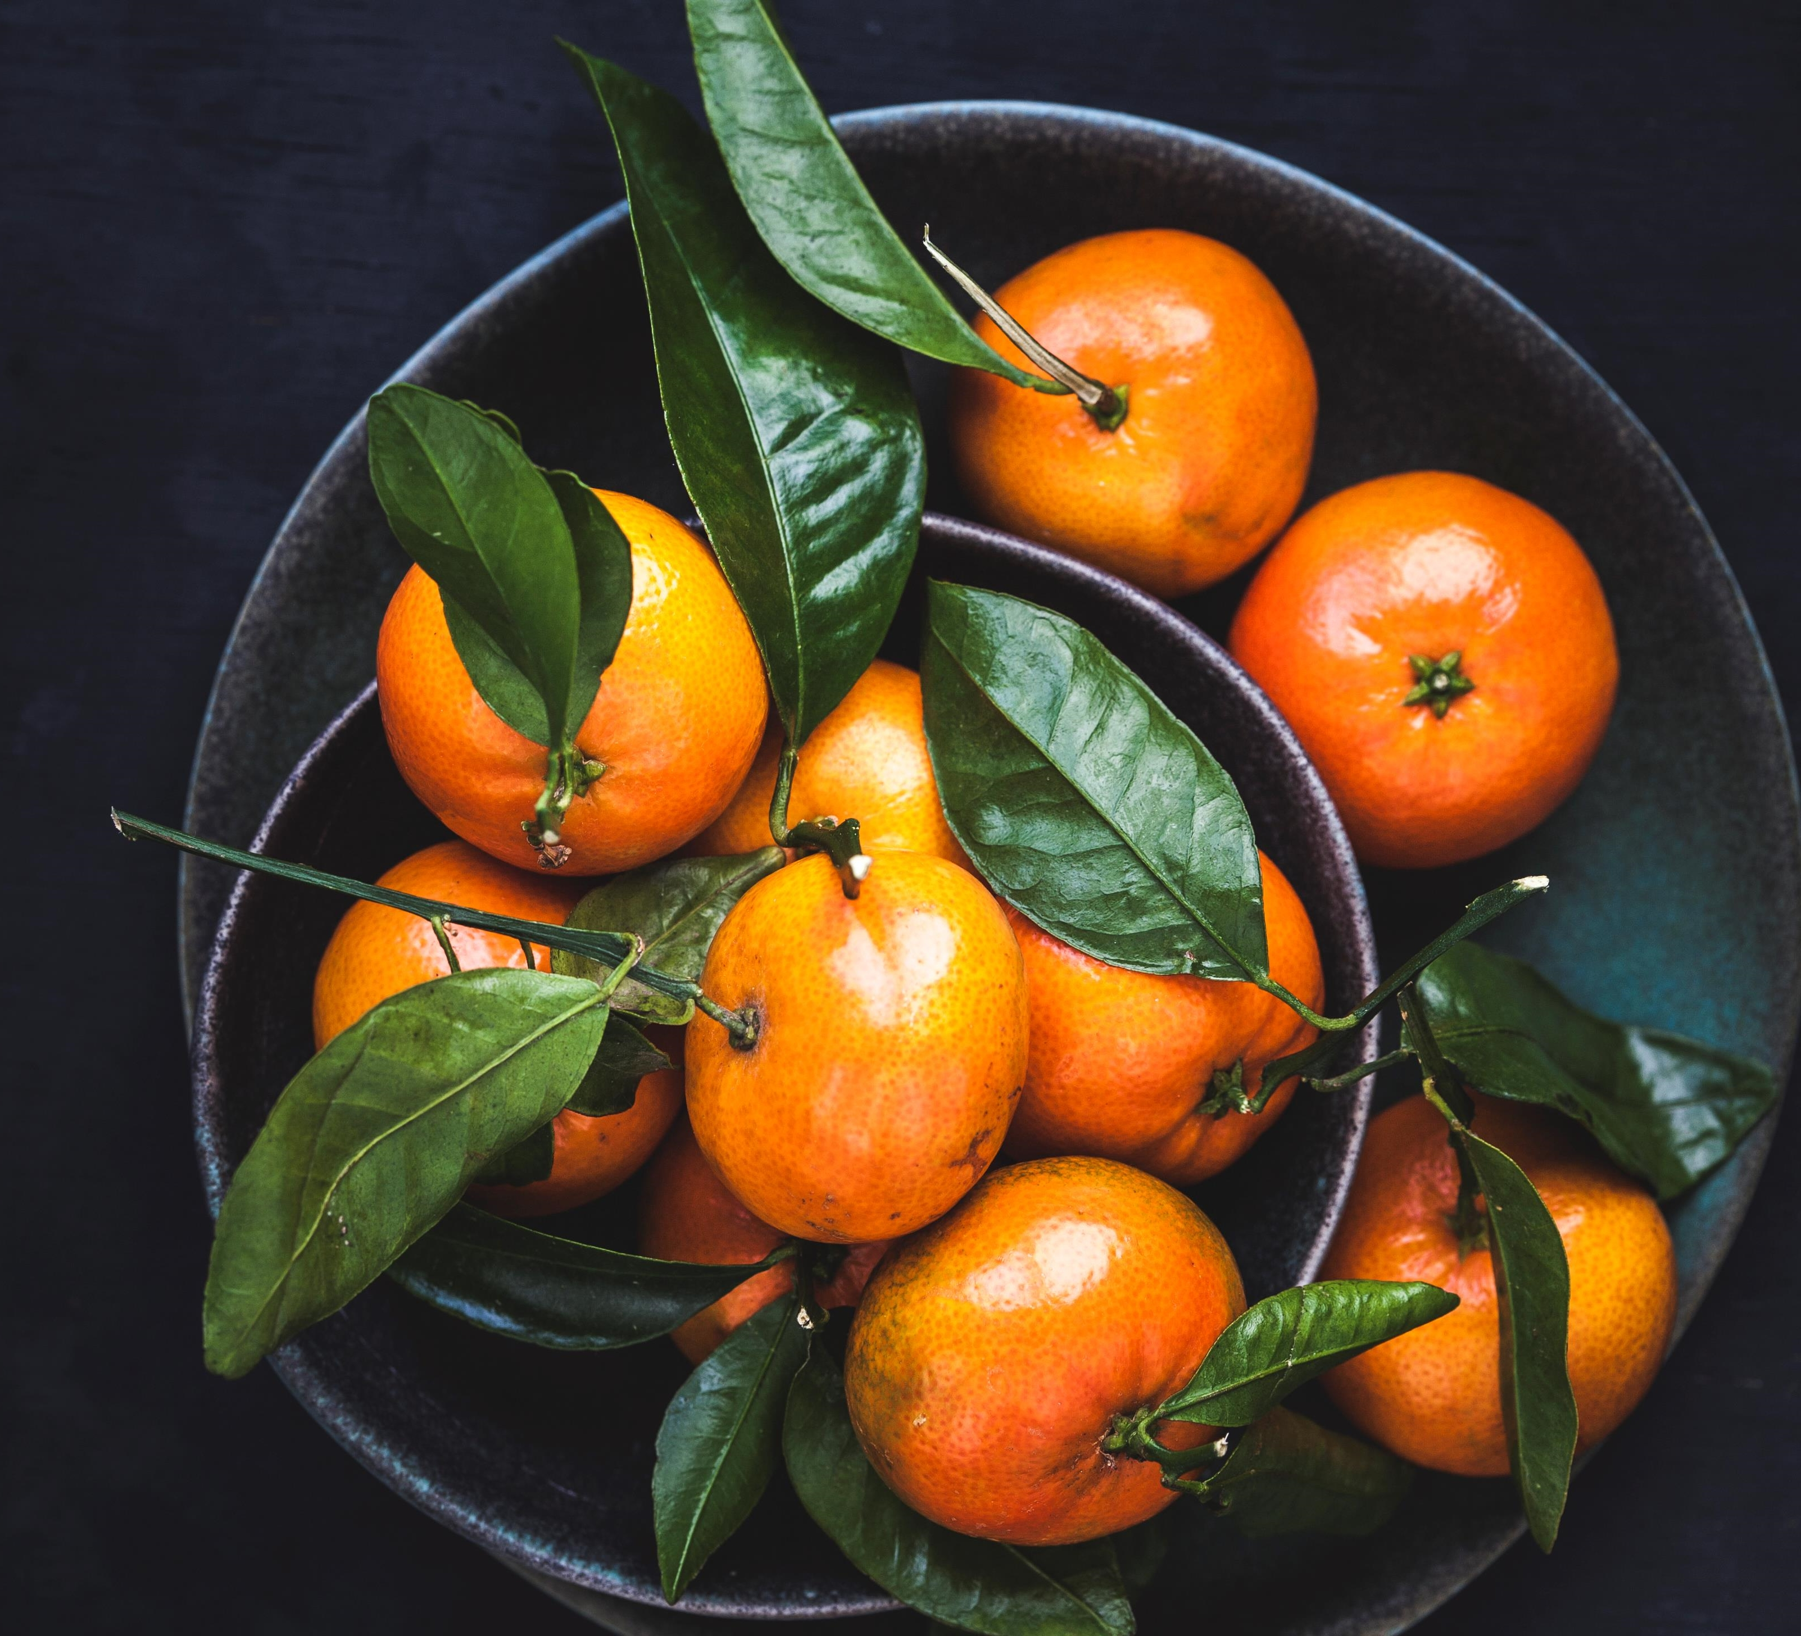
Crop Analysis and crop disease prediction
Guide: DR. R. GEETHA RAMANI
Submitted By :
Samundar Singh
2019272033 (MCA(S.s))

Slide 2
Introduction
India is an Agriculture based economy whose most of the GDP comes from farming. Climate and other environmental changes have become a major threat in the agriculture field. Machine learning is an essential approach for achieving practical and effective solutions for this problem Predicting yield from historic crop yield and guide farmers that which crop is suitable to grow now and what are the other factors that is needed to maximize the profit or yields of crops

Slide 3
Existing Module
In existing module the yield is prediction is done using weak dataset and also the dataset is not efficient to give suggestion about the fertilizers and irrigation suggestion to the farmer.
Mostly the data that I found in Kaggle are spitted and not more accurate(Accurate in sense of data mismatch prediction is doing for a particular crop and fertilizer suggestion is given for some another)

Slide 4
Proposed Module
This project have various modules that help Farmers to guide them in farming
Module 1:
Yield Prediction (predicting yields using regression by help of historical data)
Module 2:
Fertilizers and Irrigation Suggestion (If the farmer Wants to increase the Yields).
Module 3:
Weather Analysis like Temperature, Rainfall, Wind (Presenting both forecast as well as historical data) and livestock's suggestion.
Module 4:
Plant Disease detection (Using Deep Learning techniques (CNN) )

Slide 5
Workflow Diagram
Nitrogen, Phosphate, Potash consumption
Irrigated area
Output
Rain
Temp
Wind
Leaf disease
Remedies
Classified Detection
Regression model - 2
(predict fertilizers when yield is given as input)
Regression model - 3
(predict Irrigation when yield is given as input)
Analysis Module
(using plotly to show analyzed Data)
DCNN Model
Yield per hectare
Convert to an Array Comparison
Regression model - 1
(predict yield when area is given as input)
Training dataset
Image preprocessing
Removing the Background
User input area ,crop type, location
User input image of leaf
input
User input district
User input district, crop type
Module 2
Module 1
Module 2
Module 4

Slide 6
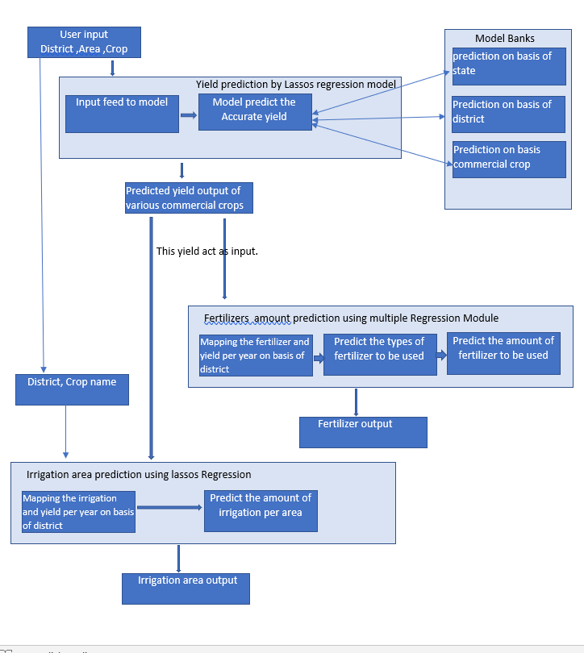
Architecture Diagram - (1)
Yield prediction and irrigation and fertilizer suggestion

Slide 7
Module 1
In this module the various Agricultural Crop area ,production and yield data is taken according to the historical data the yield is going to be predicted.
For better accuracy I used the lassos regression model.
The user have to input the state ,district and type of crop on behalf of that the yield is predicted
The predicted yield is feed as input to the other module-2 as input.

Slide 8
Module 2
In this module the fertilizer and irrigation are predicted on behalf of the yields.
If a farmer wants to increase its yield then this module will suggest at what extent the fertilizer amount and irrigation supply is need to be increased.
I am using Multiple regression Module that help in the prediction (type of regression is under observation.)

Slide 9
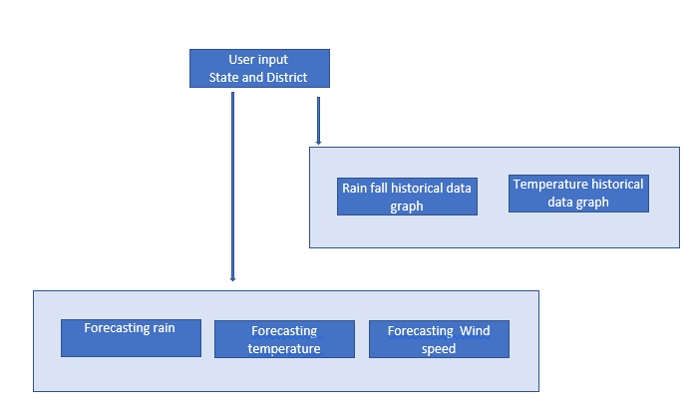
Architecture Diagram - (2)
For weather forecasting and history data

Slide 10
Module 3
In this module a statistical representation is shown which will show the climate information regarding Agriculture on basis of Historical data .
This module is also capable of forecasting the Rain, temperature and wind.
The user have to insert the state and District in order to retrieve data.

Slide 11
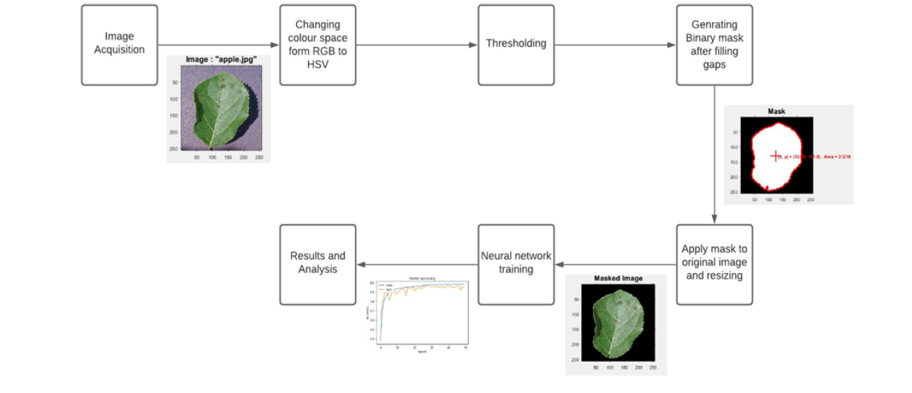
Architecture Diagram - (3)
For plant disease detection
Dense Convolution Neural Network (DCNN)

Slide 12
Module 4
This module is based on research paper named “MULTIPLE PLANT LEAF DISEASE CLASSIFICATION USING DENSENET-121 ARCHITECTURE” Issue 5, May 2021
In this module background information which is unnecessary for disease detection in leaves of crops is omitted
This is overcome by RGB color form image to HSV form, segmenting required portion of image by histogram based thresholding and hole-filling ending into a binary mask image and then masked by dot multiplication on the binary mask, finally resizing it for neural network training.

Slide 13
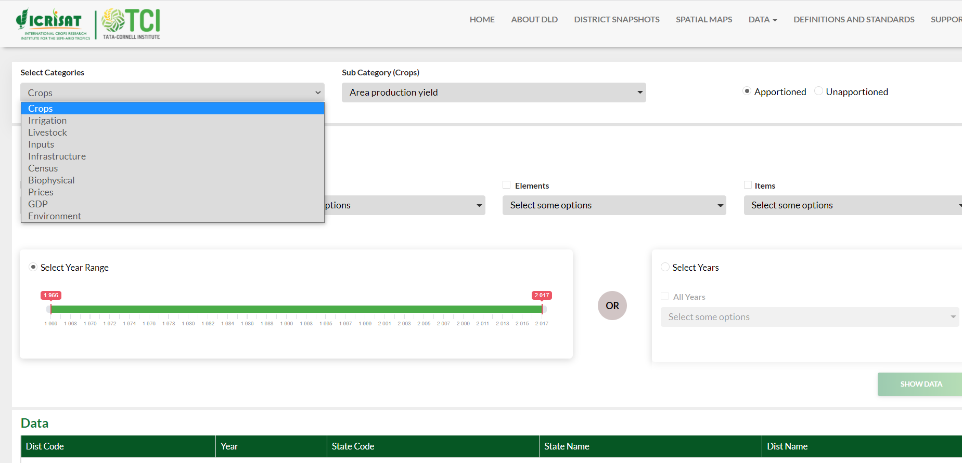
dataset
I found a very rich dataset from :
http://data.icrisat.org/dld/index.html
These are the data which is needed in project :
Crop Production(yields) Dataset.
Monthly Rainfall Dataset
Fertilizers Dataset
Irrigation Dataset
Plant Disease Dataset

Slide 14
Tech-Stack Used
Front-end: Angular, Html
Backend: Nodejs, python
Other tools and library: keras,Jupiter notebook Scikit-learn

Slide 15
Reference paper
https://iaeme.com/MasterAdmin/Journal_uploads/IJEET/VOLUME_12_ISSUE_5/IJEET_12_05_005.pdf
https://ieeexplore.ieee.org/document/9243422
https://ieeexplore.ieee.org/abstract/document/9155815
https://www.sciencedirect.com/science/article/pii/S0168169920302301

Slide 16
Thank You

